Slide 1
ISTQB
Ivan Cipriani

Slide 2
Agenda
Intro
What is Testing?
Why is Testing Necessary?
Seven testing principles
Test Activities
Essential skills

Slide 3
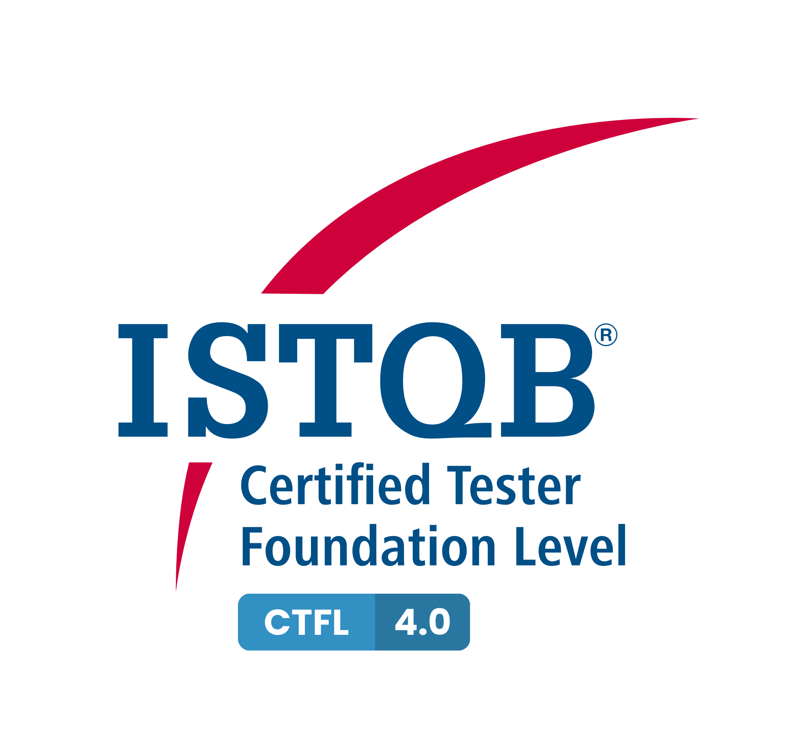
Intro
Overview
The ISTQB® Certified Tester Foundation Level (CTFL) certification provides essential testing knowledge that can be put to practical use and, very importantly, explains the terminology and concepts that are used worldwide in the testing domain. CTFL is relevant across software delivery approaches and practices including Waterfall, Agile, DevOps, and Continuous Delivery. CTFL certification is recognized as a prerequisite to all other ISTQB® certifications where Foundation Level is required.
Audience
The Foundation Level certification is suitable for anyone who needs to demonstrate practical knowledge of the fundamental concepts of software testing including people in roles such as testers, test analysts, test engineers, test consultants, test managers, user acceptance testers, and software developers.
It is also appropriate for individuals who need a basic understanding of software testing including project managers, quality managers, software development managers, business analysts, IT directors, and management consultants.

Slide 4
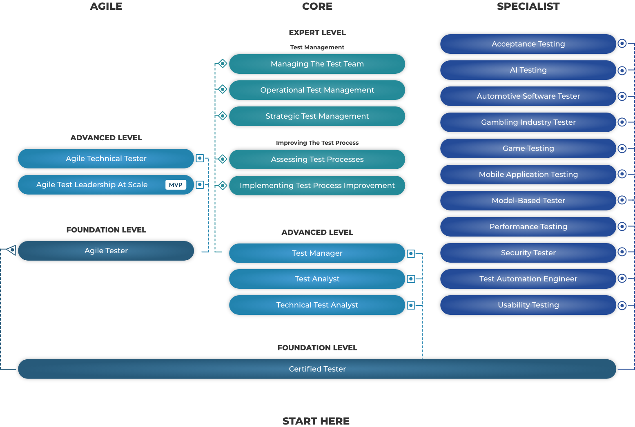
Intro

Slide 5
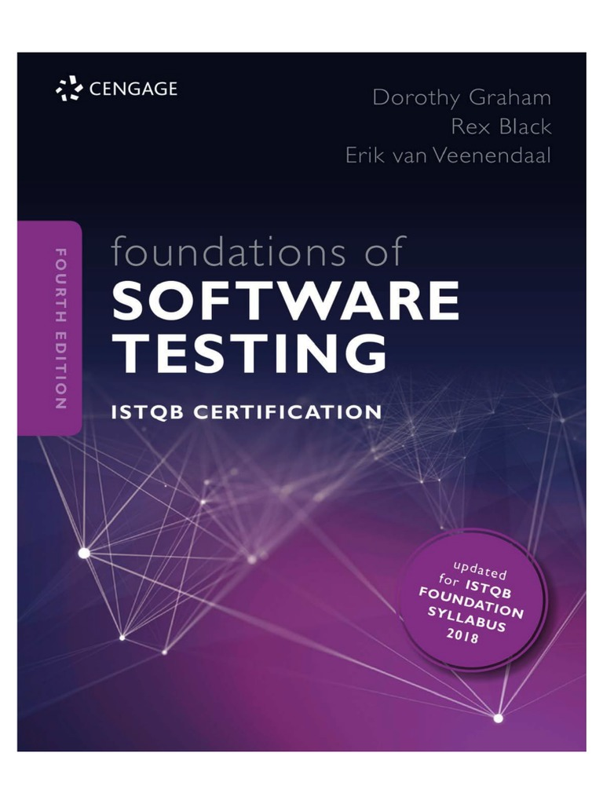


Intro
Exams based on the CTFL v3.1 syllabus will be available until 9th May 2024 for English
Exams based on the CTFL v4.0 book will be available in 2024
Notes:
Third one only official book
Secon and third version 4.0 but next year
Fisrt one old version still valid

Slide 6
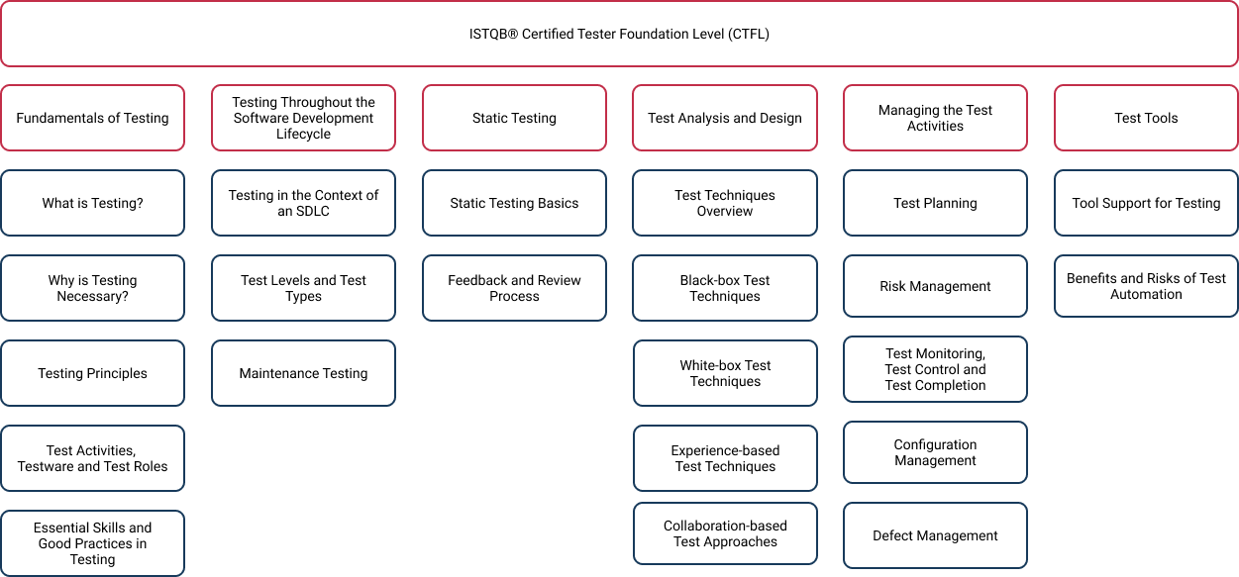
Intro
Notes:
Documentation free book

Slide 7
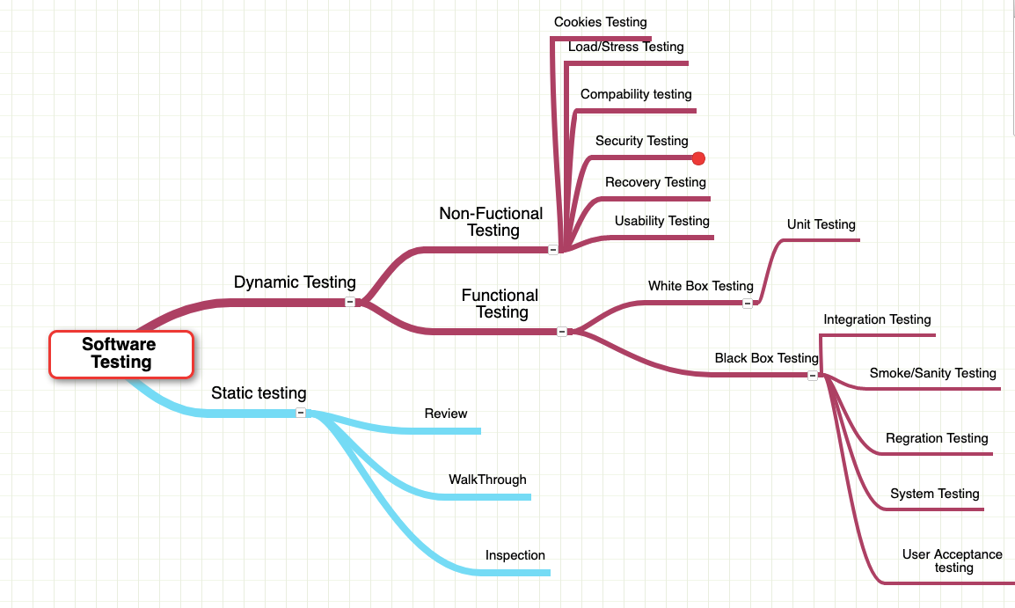
What is Testing?
With running code
Informal
Running code
Without running code
Formal
Notes:
The process consisting of all lifecycle activities, both static and dynamic, concerned with planning, preparation and evaluation of a component or system and related work products to determine that they satisfy specified requirements, to demonstrate that they are fit for purpose and to detect defects.
Static testing in the next presentation
Related work product not only the final releasable product

Slide 8
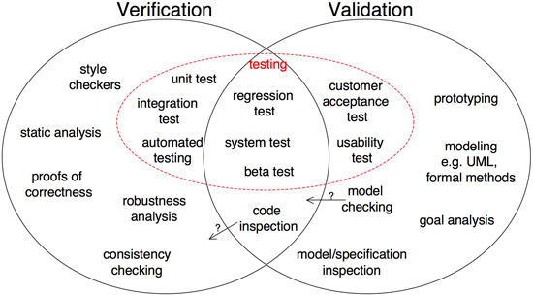
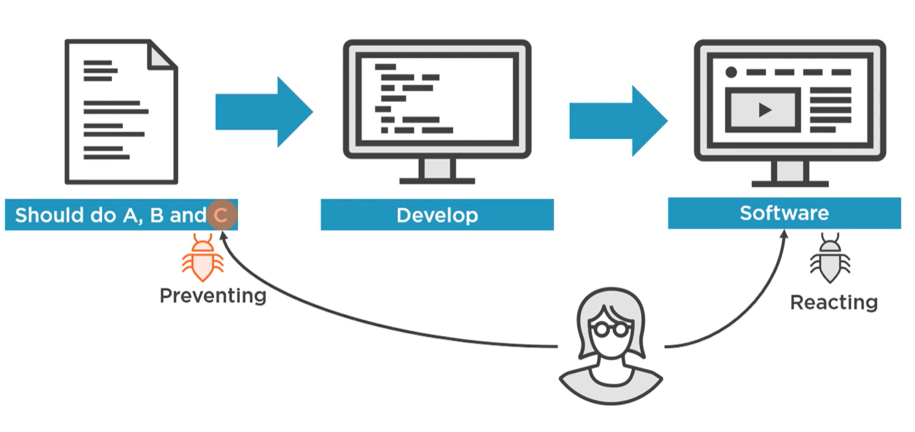
What is Testing?
Are we building the product right?
Are we building the right product?
Notes:
On the we some article have Verification --> static validation --> dymanic not true for me maybe before with V-Model...?
Review best one
Reaction best two
Image in blue is a similar view on the sckets below
Introduction and purpose
The purpose of the testing and inspection procedure is to establish and define the process for testing and inspection activities that verify product, material and service conformance, and to verify that process inputs and outputs conform to specified requirements.
Robustness testing is a type of testing that is performed to assess the ability of a system or component to function correctly when it is subjected to invalid or unexpected inputs, or when it is operating outside of its specified operating conditions. It is typically used to test for the presence of memory leaks or other types of errors that can cause a system to crash. Robustness testing is also sometimes referred to as reliability testing, stress testing, or endurance testing.
A proof of correctness is a mathematical proof that a computer program or a part thereof will, when executed, yield correct results, i.e. results fulfilling specific requirements. Before proving a program correct, the theorem to be proved must, of course, be formulated
A consistency check is a test performed to determine if the data has any internal conflicts. More specifically, whether or not the rules written for data have contradictory statements. For example, a consistency check is often run to ensure a package's shipping date is not before the order date.
Five Steps of Goal Analysis
The book gives a simple, five-step process for analyzing your goals and making them concrete. Those steps are:
Write down the goal
Write down everything a person would have to do for you to agree that he or she has met the goal
Review the items you listed in step 2 and revise
Write a complete sentence that describes each of the items on your list after step 3
Test the sentences you wrote in step 4 to make sure they're complete
We'll take a further look at each of the steps in the sections below.

Slide 9
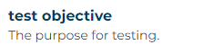
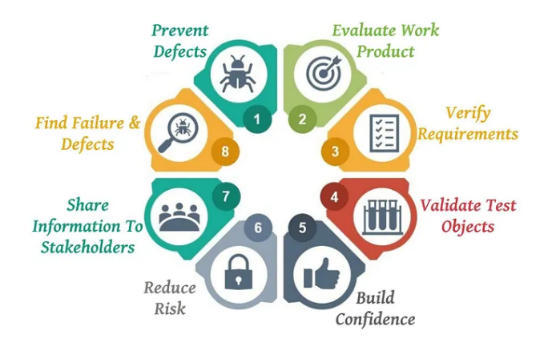
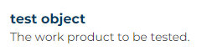
What is Testing?
Notes:
Not universal and can be different for each type of test
Prevent defects: One of the objectives of software testing is to avoid mistakes throughout the development process. The cost and labor associated with error detection are considerably reduced when faults are detected early. It also saves time. Defect prevention entails conducting a root cause analysis of previously discovered flaws and then taking specific steps to prevent the recurrence of those types of faults in the future.
Evaluate work products: The objectives are used to assess work items such as the requirement document, design, and user stories. Before the developer picks it up for development, it should be confirmed. Identifying any ambiguity or contradictory requirements at this stage saves a significant amount of development and testing time.
Verify Requirements: This objective demonstrates that one of the most important aspects of testing should be to meet the needs of the client. Testers examine the product and ensure that all of the stipulated standards are met. Developing all test cases, independent of testing technique, ensures functionality confirmation for every executed test case.
Validate test objects: Testing ensures that requirements are implemented as well as that they function as expected by users. This type of testing is known as validation. It is the process of testing a product after it has been developed. Validation can be done manually or automatically.
Build confidence: One of the most important goals of software testing is to improve software quality. A lower number of flaws is associated with high-quality software.
Reduce risk: The probability of loss is sometimes referred to as risk. The goal of software testing is to lower the likelihood of the risk occurring. Each software project is unique and has a substantial number of unknowns from several viewpoints. If we do not control these uncertainties, it will impose possible hazards not only during the development phases but also during the product’s whole life cycle. As a result, the major goal of software testing is to incorporate the risk management process as early as possible in the development phase in order to identify any risks.
Share information to stakeholders: One of the most essential goals of testing is to provide stakeholders with enough information to allow them to make educated decisions, particularly on the degree of quality of the test object. The goal of testing is to offer complete information to stakeholders regarding technological or other constraints, risk factors, confusing requirements, and so on. It can take the shape of test coverage, testing reports that cover specifics such as what is missing and what went wrong. The goal is, to be honest, and ensure that stakeholders fully grasp the challenges influencing quality.
Find failures and defects: Another critical goal of software testing is to uncover all flaws in a product. The basic goal of testing is to uncover as many flaws as possible in a software product while confirming whether or not the application meets the user’s needs. Defects should be found as early in the testing cycle as feasible.

Slide 10
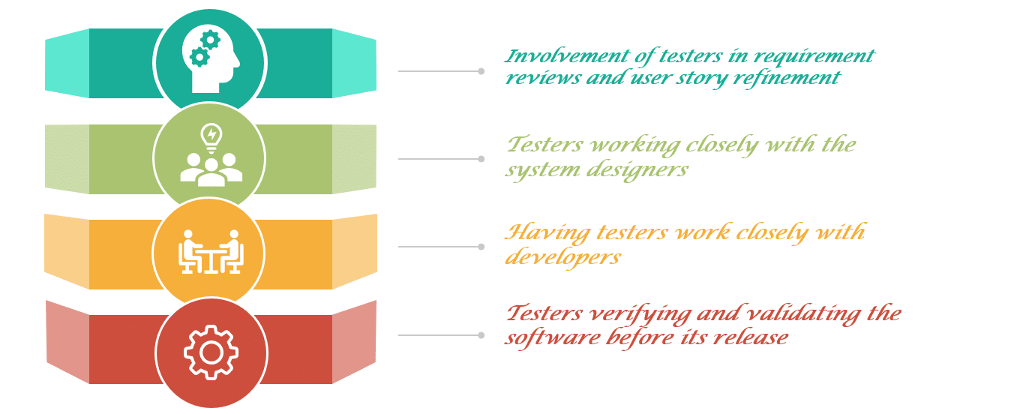
Why is Testing Necessary?
Notes:
Involvement of testers in requirement reviews and user story refinement- Involving testers during the requirement phase ensures identification of some of the requirement defects even before their implementation. It significantly reduces the fixing cost. Also, the tester gains significant project insight at this stage. Which, in turn, helps him in the execution phase of the project.
Testers working closely with the system designers- It will increase their understanding of each part of the design. Additionally, it will help in reducing the risk of fundamental design flaws and allows the identification of errors at an early stage. Moreover, it also improves the quality of integration scenarios and results in a better quality of defects.
Having testers work closely with developers- When testers work closely with developers, it enhances their understanding of each part of the code. It further enables testers to do more efficient testing against customer requirements. Thereby reducing the risk of defect slippage. Testers also become aware of areas that are considered risky by the developer so they can adjust their priorities accordingly. Additionally, developers also get the tester's insight. This helps in reproducing the bugs there and then, without going through a lengthy defect management process.
Testers verifying and validating the software before its release- This helps in detecting errors that otherwise may have gone unnoticed, and support the process of eliminating the defects that caused the failures. The execution of tests at various levels increases the likelihood that the software will have fewer errors and also meet the customer's needs.

Slide 11
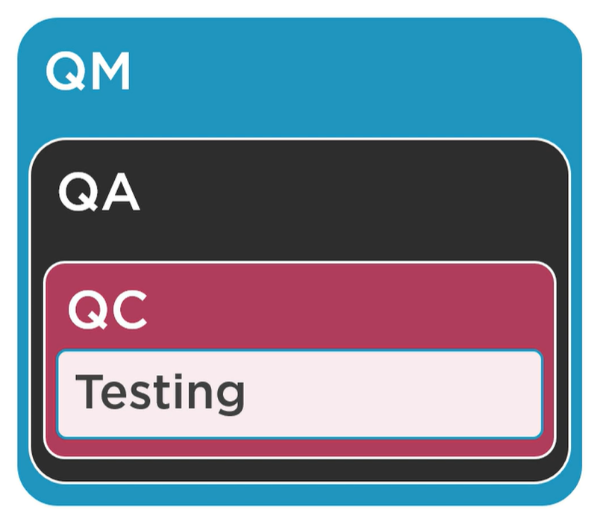

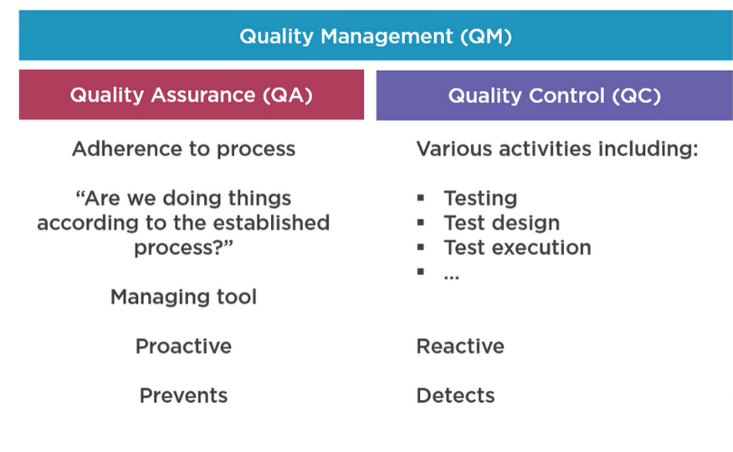
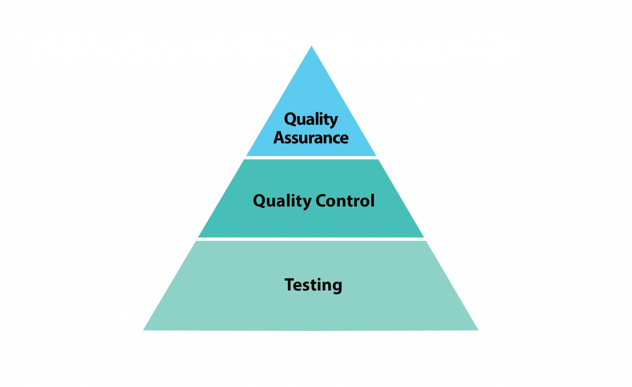
Why is Testing Necessary?
Notes:
What is Quality Management?
Quality management is the process that ensures that only the best products are developed and delivered to customers through a well-planned and structured process. It is a combination of two approaches - Quality Assurance and Quality Control.
Quality Assurance and Quality Control are both parts of Quality Management. Together they ensure that the deliverables are of high quality and meet the expectations of the customers. The below figure shows this relation.
Some of the benefits of Quality Management are as follows:
Firstly, it brings a higher level of customer satisfaction. Which, in turn, translates into a better brand reputation in the industry.
Secondly, it produces a highly motivated & dedicated team that participates actively in the processes of quality assurance and quality control.
Thirdly, it identifies defects across the software life-cycle. In addition to that, it ensures that the end product meets customer expectations.
Moreover, it leads to appropriately planned methods and processes that save time, money, and efforts.
Quality Assurance - A Defect Prevention Activity
“The conformance to requirements is Quality". Quality assurance (QA) is the process of verifying whether a product meets the required specifications and the expectations of the client. This process ensures that you are doing the right thing in the right way, using the proper techniques. In addition to that, its primary focus is to prevent defects in the system.
Quality Assurance is static testing. In other words, it comes under "Verification" with the primary purpose of the prevention of defects. Quality Assurance is carried out across the entire product life cycle (SDLC), from the requirements phase to project closure.
The static testing types used in Quality Assurance are:
Informal Reviews - The reviews which don't need documentation/ planning. Usually, the author will present the documents, and the audience will provide their viewpoints. These may or may not require documentation. Moreover, it's up-to-the author whether to accept or reject the feedback.
Peer Review - This is, again, an informal method where colleagues can check each other's work product and provide feedback. It doesn't require formal documentation of feedback. Additionally, it's up to the author to accept or reject the feedback.
Walk-through - This is a bit formal, where a lead or a manager would walk-through the document. It involves the official recording of the feedback, and the author incorporates the feedback. E.g., A QA Lead will do the walk-through of the automation scripts that a team member would have created.
Inspection - This is the most formal review method. Where a higher authority like a client QA Manager or an Enterprise Architect will review the work product (e.g., Automation Framework), after that, formal documentation of these review comments happen. Finally, the author is supposed to formally share the status of the fixes and progress of these.
Quality Control - A Defect Identification Activity
Quality Control (QC) is a product-oriented activity that focuses on identifying the defect. QC involves checking the product against a predetermined set of requirements and validating that the product meets those requirements. Quality control is to inspect something (a product or a service) to make sure it works as per the defined requirements. If the product or service does not work well, then the problem must be solved or eliminated to meet the customer requirements. QC does not focus on the process. However, the main focus here is on the final product. In other words, it ensures that the final product is developed as per the quality process (Quality Assurance) and meets the client's requirements.
Quality Control is Dynamic testing - It comes under "Validation" with the primary purpose of finding defects. Dynamic testing takes place once the development of a component is complete.
The dynamic testing types used in Quality Control are:
Component Testing - Testing individual components of a System
Component Integration Testing - Testing two or more integrated components of a System
System Testing - Testing a full system when it's fully integrated
User Acceptance Testing - Tests carried out by customers to ascertain if the software is as per their requirements
Apart from that, several non-functional dynamic testing types are also a part of Quality Control. Some of these are:
Performance Testing - First is Performance Testing, which tells whether the software performs well - E.g., the pages should start loading in less than 3 seconds.
Load Testing - Second is Load Testing, which tells whether the software can take peak user load. E.g., during the Christmas season, the user load is at the peak. Hence, the software should be load tested to ensure it can sustain with this load.
Security Testing - Next is Security testing, which ensures whether the software is secure enough. Moreover, security cannot be compromised.
Recovery Testing - Finally, there is Recovery Testing. It tells whether the software can recover if something unexpected happens. For instance, if the server goes down and backs up, then the software should be able to recover.
Relationship between Quality Assurance (QA), Quality Control (QC) and Testing
The relationship between Quality Assurance (QA), Quality Control (QC) and Testing are hierarchical.
The main motto of Quality Assurance is the prevention of bugs in the software. It is more concerned with developing a quality process for software development. Which, in turn, will prevent the generation of bugs and results in the production of a quality product.
The primary goal of Quality Control is detecting errors by inspecting and testing the product. It involves comparing the product with a predetermined set of requirements and validating that the product meets those requirements.
Testing is a subset of Quality Control. It is the process of running a system to detect errors in the product to be corrected. Additionally, Testing is an integral part of quality control. Because it helps in demonstrating that the product works as expected and designed. In addition to the above, in Software Testing, we find out the problem and try to fix the problem. Which, in turn, is considered relatively easier than preventing the issue before it occurred.
The concept depicted in the figure given below :

Slide 12
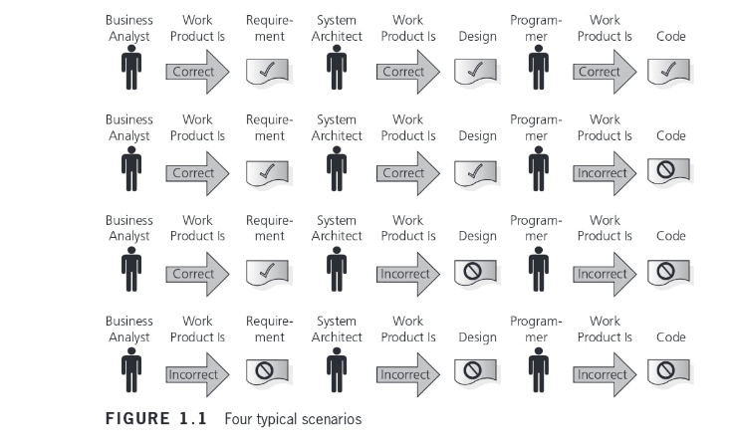
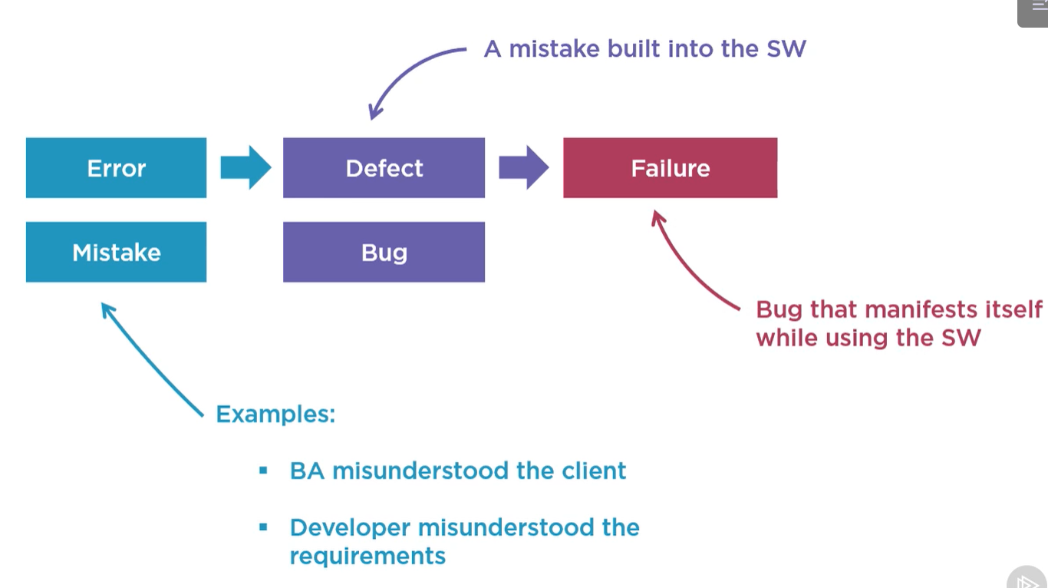
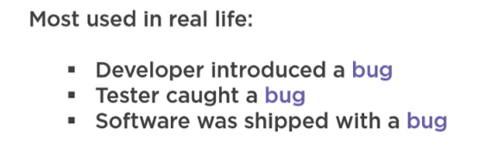
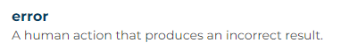

Why is Testing Necessary?
What are the causes of Errors in Software?
Notes:
Say about Developer technical writer and Businees analyst
What are the causes of Errors in Software?
Here we will discuss some possible causes of these errors.
Time pressure:
At times, software development happens under limited / insufficient resources with unrealistic deadlines. Developers do not have enough time to test their code before delivering it to the testing team. Which, in turn, introduces errors.
Human fallibility:
Human beings are prone to make mistakes. It would be foolish to expect the software to be perfect, and without any flaws in it! Ironically, we have not yet discovered any other non-human agent that can develop software better than humans. Therefore, we continue to rely on human intelligence to develop software. Thereby, increasing the possibility of errors in it.
Inexperienced or insufficiently skilled project participants:
Allocation of correct work to the correct resource is fundamental for the success of any project. Team members should be assigned a task according to their skills and abilities. An inexperienced project participant may make mistakes if they don't have proper knowledge of the work. For example, a resource having a good understanding of the database but having limited knowledge of HTML/CSS is not suitable for designing a website.
Miscommunication between project participants:
Improper coordination & poor communication between various departments in a project can result in disrupted progress. Conflicts can arise each time a project participant misinterprets or misunderstands the words or actions of another. For example, the business analyst does the requirement gathering, and then some other team member does the documentation of the requirements. Any miscommunication between the two can lead to incomplete/wrong requirement document, which, in turn, affects the design of the project.
The complexity of the code, design, architecture, or the technology to be used:
As the complexity of the program, concerning code, design or technology increases, the software becomes more critical and more bugs appear. It is because our brains can only deal with a reasonable amount of complexity or change. Our minds may not be able to process complex information like the form of design, architecture or technology, etc. Therefore, resulting in low quality and erroneous coding.
Misunderstandings about intra-system and inter-system interfaces: There are high chances of error while establishing an intra-system, and inter-system interfaces. Let's try to understand what is intra-system and inter-system interfaces mean:-
Intra-system interface- It implies the integration of different modules/features within a system/application. For example, in an online shopping portal, we have three modules: online order, shipping, and supply chain. These three modules form the intra-system for the online shopping portal. When these different modules are combined, there is a possibility of errors in the final product.
The inter-system interface- It is the compatibility of an application with other applications when operated together. For example, compatibility between smartphones and tablets while data transfer via Bluetooth.
New, unfamiliar technologies:
Sometimes, the developers and testers need to develop an application using a technique that is unknown to them. Lack of proper knowledge and understanding can lead to errors. At that time, they require a certain level of R & D, brainstorming, and training to reach a reliable solution.
Environmental conditions:
Natural disasters, such as outbreaks of fires, floods, lightning, earthquakes, etc. can affect the computers. For example, a system may not work correctly if the software inside is affected by radiation, electromagnetic, or pollution.

Slide 13
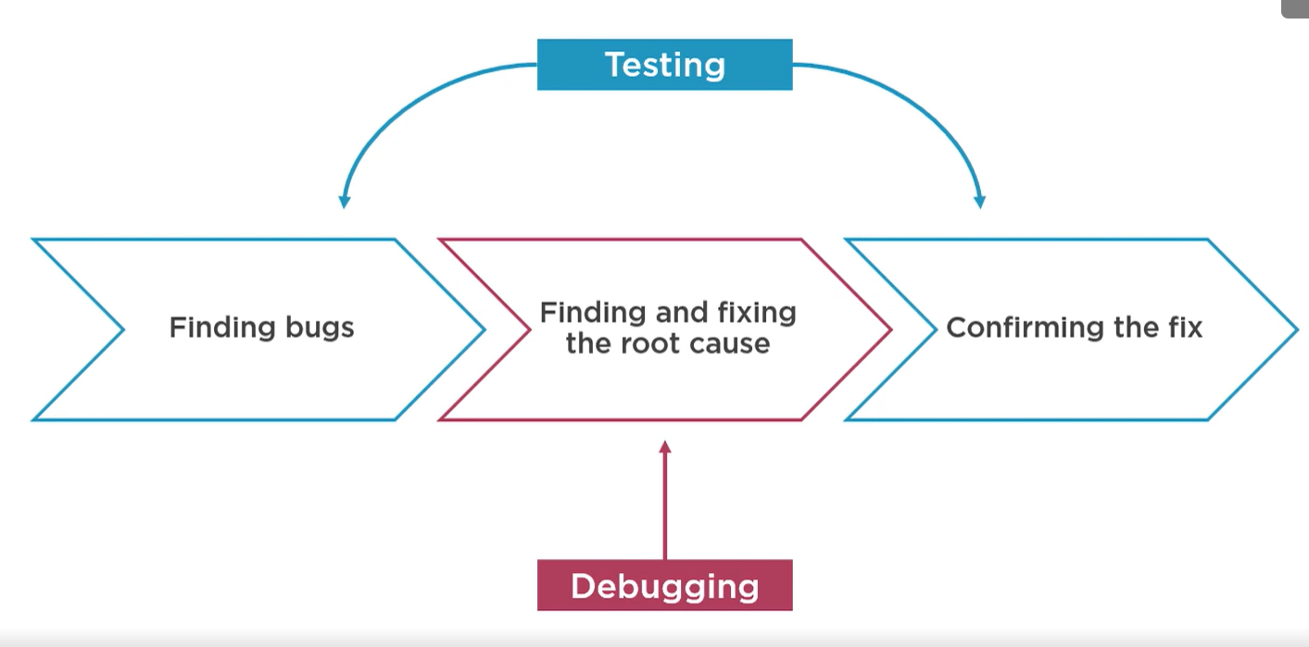
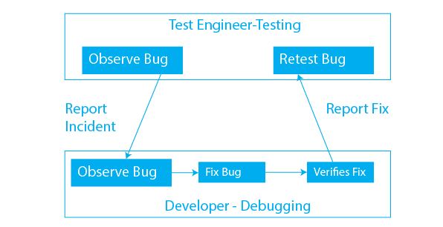
Why is Testing Necessary?

Slide 14
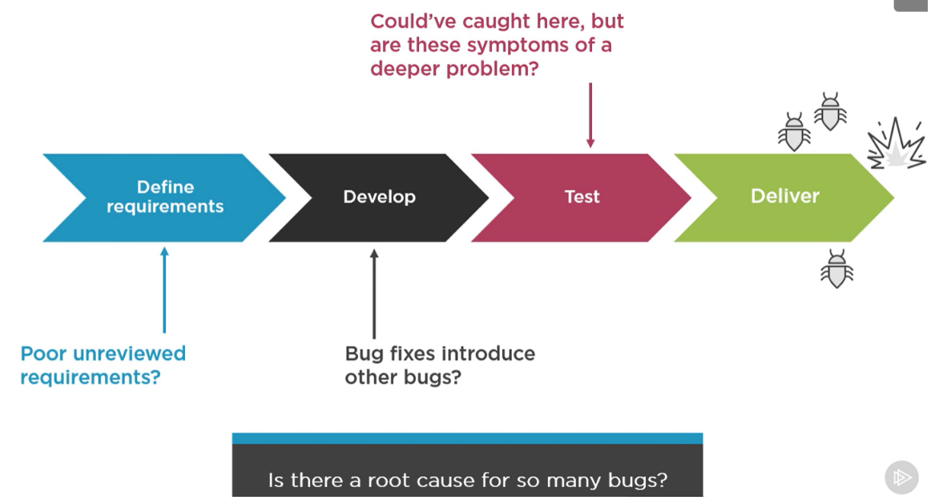
Why is Testing Necessary?

Slide 15
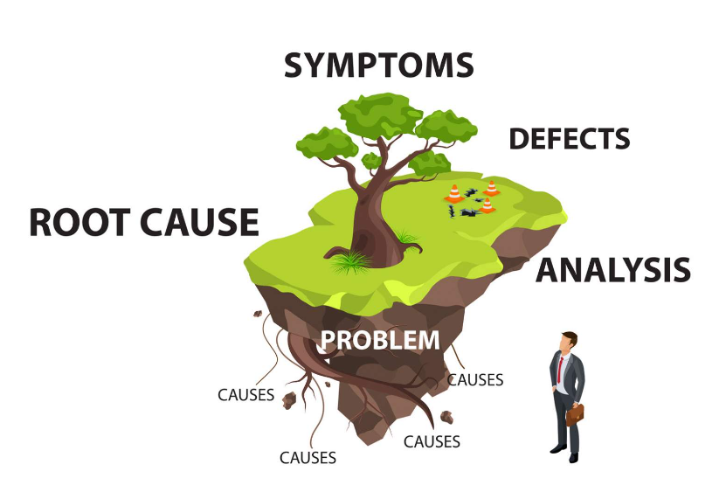
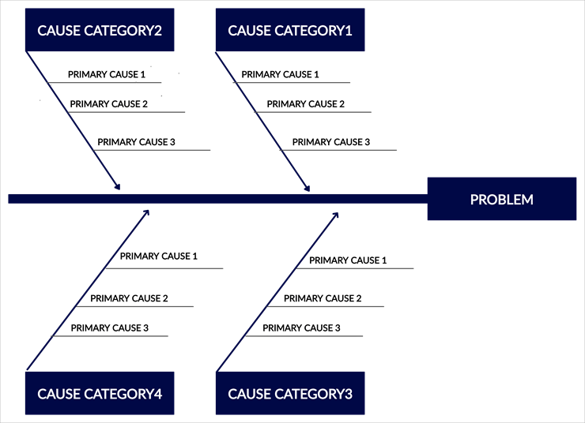
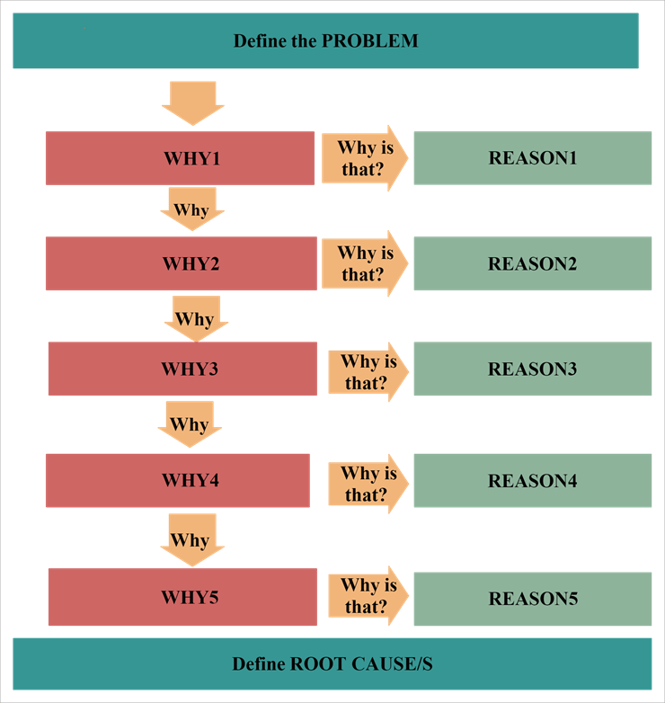
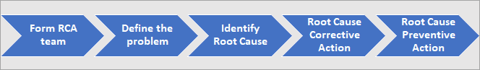
Why is Testing Necessary?
ERROR
Notes:
What are the causes of Errors in Software?
Here we will discuss some possible causes of these errors.
Time pressure: At times, software development happens under limited / insufficient resources with unrealistic deadlines. Developers do not have enough time to test their code before delivering it to the testing team. Which, in turn, introduces errors.
Human fallibility: Human beings are prone to make mistakes. It would be foolish to expect the software to be perfect, and without any flaws in it! Ironically, we have not yet discovered any other non-human agent that can develop software better than humans. Therefore, we continue to rely on human intelligence to develop software. Thereby, increasing the possibility of errors in it.
Inexperienced or insufficiently skilled project participants: Allocation of correct work to the correct resource is fundamental for the success of any project. Team members should be assigned a task according to their skills and abilities. An inexperienced project participant may make mistakes if they don't have proper knowledge of the work. For example, a resource having a good understanding of the database but having limited knowledge of HTML/CSS is not suitable for designing a website.
Miscommunication between project participants: Improper coordination & poor communication between various departments in a project can result in disrupted progress. Conflicts can arise each time a project participant misinterprets or misunderstands the words or actions of another. For example, the business analyst does the requirement gathering, and then some other team member does the documentation of the requirements. Any miscommunication between the two can lead to incomplete/wrong requirement document, which, in turn, affects the design of the project.
The complexity of the code, design, architecture, or the technology to be used: As the complexity of the program, concerning code, design or technology increases, the software becomes more critical and more bugs appear. It is because our brains can only deal with a reasonable amount of complexity or change. Our minds may not be able to process complex information like the form of design, architecture or technology, etc. Therefore, resulting in low quality and erroneous coding.
Misunderstandings about intra-system and inter-system interfaces: There are high chances of error while establishing an intra-system, and inter-system interfaces. Let's try to understand what is intra-system and inter-system interfaces mean:-
Intra-system interface- It implies the integration of different modules/features within a system/application. For example, in an online shopping portal, we have three modules: online order, shipping, and supply chain. These three modules form the intra-system for the online shopping portal. When these different modules are combined, there is a possibility of errors in the final product.
The inter-system interface- It is the compatibility of an application with other applications when operated together. For example, compatibility between smartphones and tablets while data transfer via Bluetooth.
New, unfamiliar technologies: Sometimes, the developers and testers need to develop an application using a technique that is unknown to them. Lack of proper knowledge and understanding can lead to errors. At that time, they require a certain level of R & D, brainstorming, and training to reach a reliable solution.
Environmental conditions: Natural disasters, such as outbreaks of fires, floods, lightning, earthquakes, etc. can affect the computers. For example, a system may not work correctly if the software inside is affected by radiation, electromagnetic, or pollution.
Enlisted below are some of the benefits, you will get:
Prevent the reoccurrence of the same problem in the future.
Eventually, reduce the number of defects reported over time.
Reduces developmental costs and saves time.
Improve the software development process and hence aiding quick delivery to market.
Improves customer satisfaction.
Boost productivity.
Find hidden problems in the system.
Aids in continuous improvement.
Troubleshooting vs. root cause analysis
RCA and troubleshooting are different processes. Troubleshooting and general problem-solving methodologies solve specific problems. For example, if an application's health monitoring reveals that a software instance crashed and is unresponsive, the team may resolve the problem by restarting the software instance or rebooting the server.
Root cause analysis for software defects, however, might reveal that the software becomes unresponsive because of a certain error condition. Perhaps the application can't access data, and the software isn't designed to handle such errors gracefully. In response, the team can release a software patch that addresses the error handling and will likely prevent the problem from recurring.

Slide 16
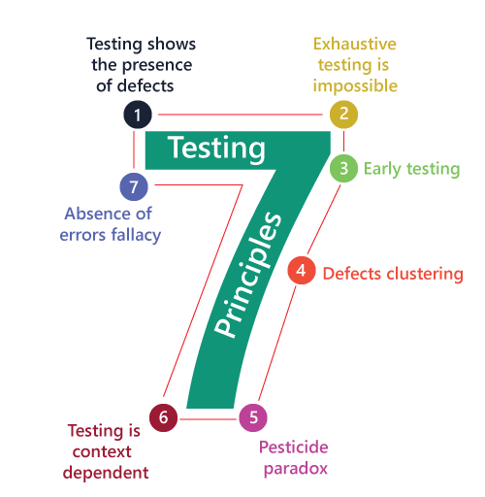
Seven testing principles
Notes:
From obsevation of the last 40 years
Testing shows the presence of defects: The first principle of software testing is that testing is a process to identify defects or errors in the software. Testing helps to identify issues in the software and helps to determine the quality of the software.
Exhaustive testing is impossible: It is not possible to test all possible combinations and permutations of input data for any complex software system. It is important to prioritize and select a subset of test cases that are critical to the system’s functionality and performance.
Early testing: Testing should be conducted as early as possible in the software development life cycle. Early testing helps to identify defects and issues early in the development process, which can save time and cost of fixing defects later in the cycle.
Defects clustering: Defects clustering principle states that a small number of modules or areas in the software system are responsible for the majority of defects. This is the Principle known as ‘ 80% of the issues come from 20% of features.’ It is important to focus testing on these critical areas .
Pesticide paradox: The pesticide paradox principle states that no new defects will discover if you run the same test cases again and again after a certain period. So need to keep reviewing and updating your test suites to ensure that they are effective in detecting new defects.
Testing is context-dependent: Testing is context-dependent and should be developed according to the software’s requirements, complexity, and dependency. The testing strategy and approach should be tailored to meet the specific needs of the software system.
Absence of errors fallacy: Absence of errors fallacy principle states that testing can never prove the absence of defects in the software system. Testing only helps to identify defects and errors in the system. Therefore, it is important to continue testing the system throughout its life cycle to ensure that it meets the required quality standards.

Slide 17
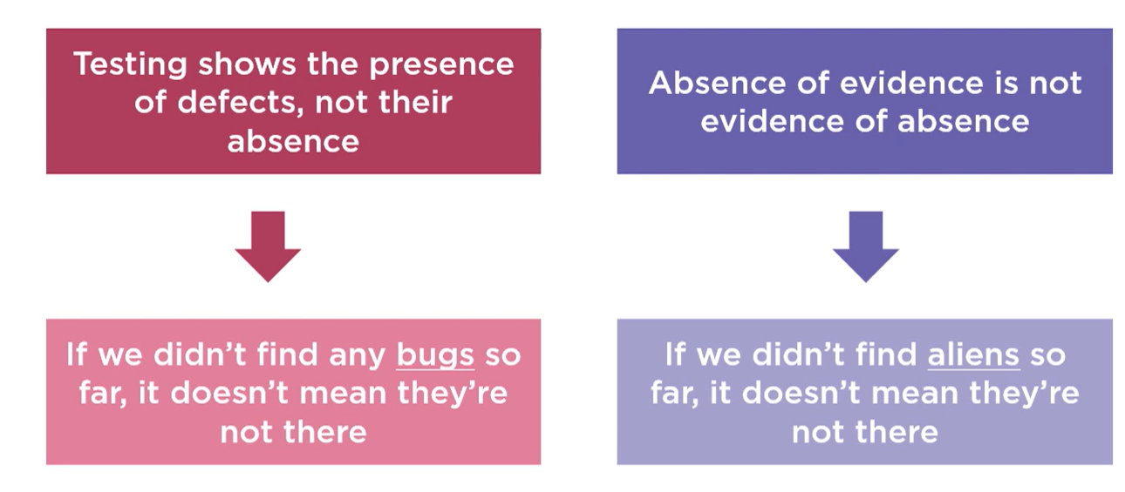
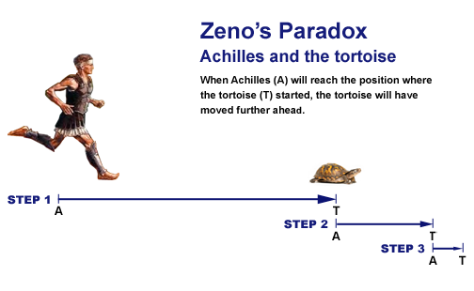
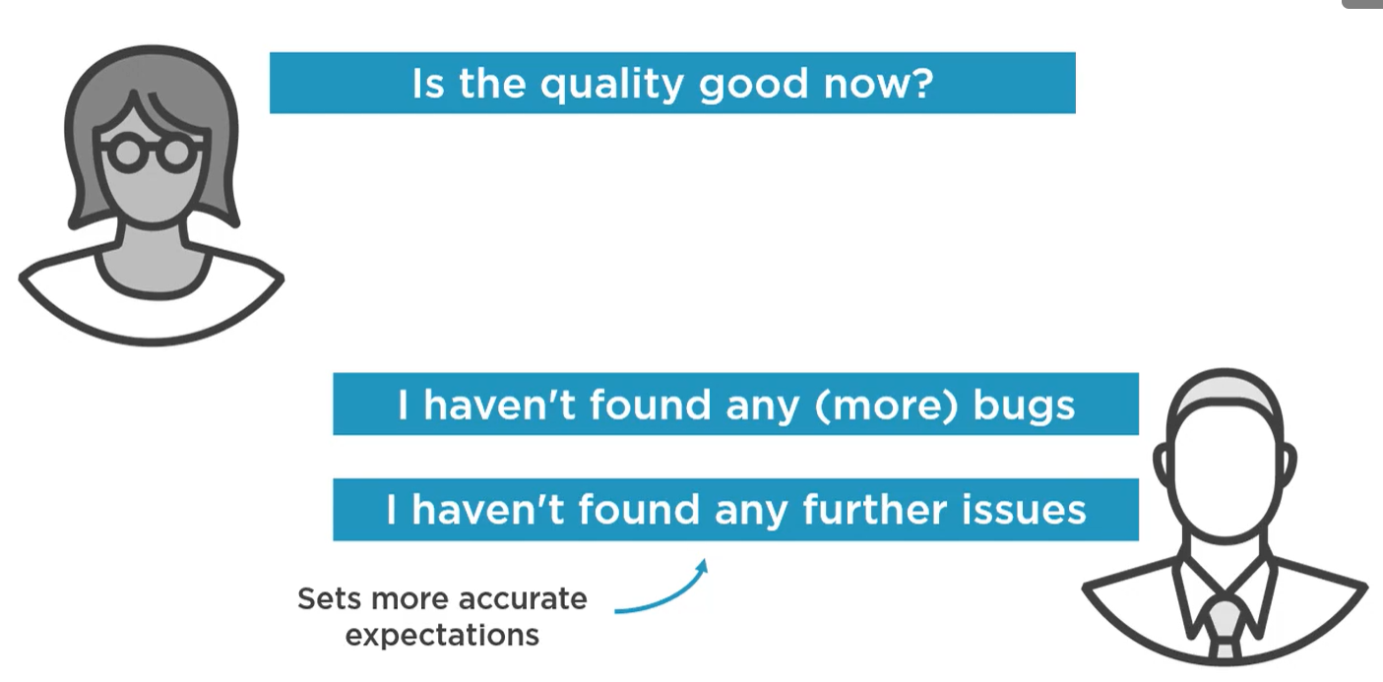
Seven testing principles --> (Testing shows the presence of defects)
Each additinal test run mat cut the risk of a remaing defect in half, but only an infinitive number of tests can cut the risk down to zero

Slide 18
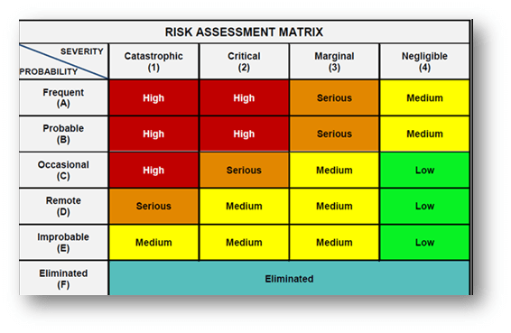
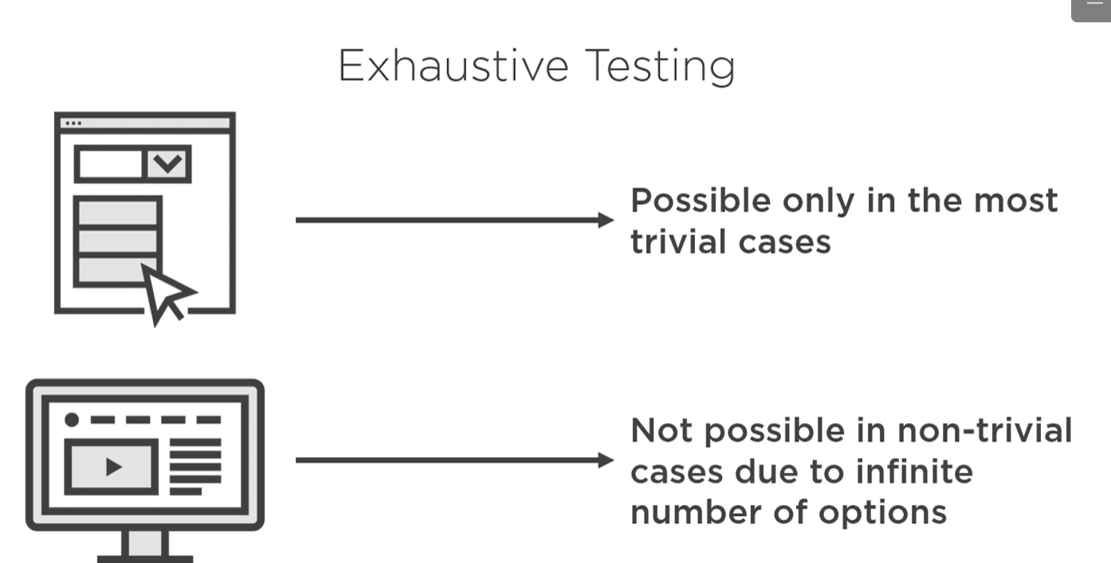
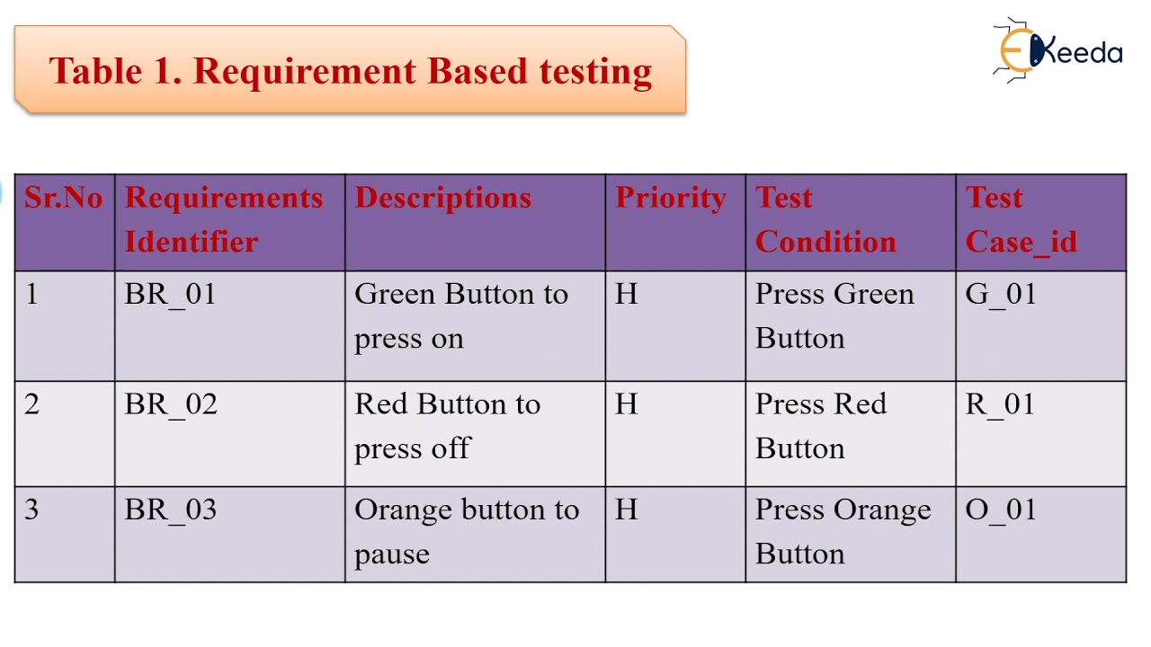
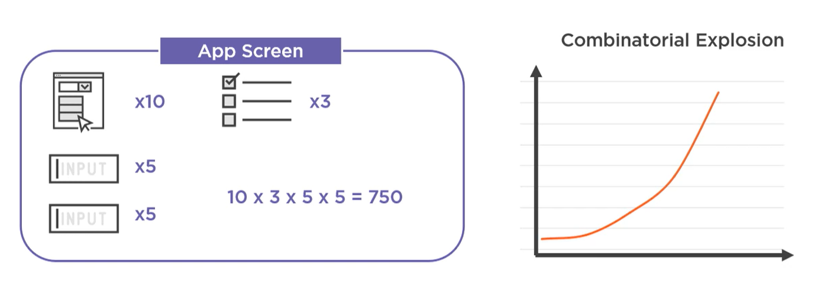
Seven testing principles --> (Exhaustive testing is impossible)
Risk-based testing
Requirements-based testing
Notes:
Closely related to the previous one
Some test strategy

Slide 19
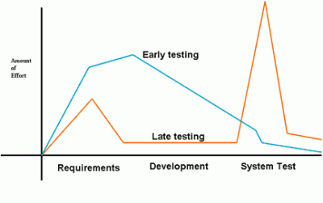
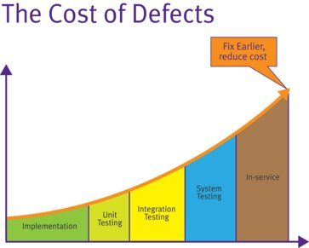
Seven testing principles --> (Early testing saves time and money)
Notes:
Shift-left
Effort is equal fo saving time

Slide 20
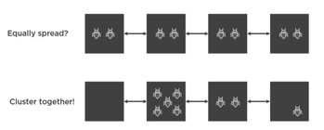
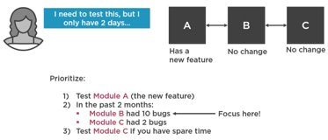
Seven testing principles --> (Defects cluster together)
Notes:
Normally bug are not equally distribuited

Slide 21
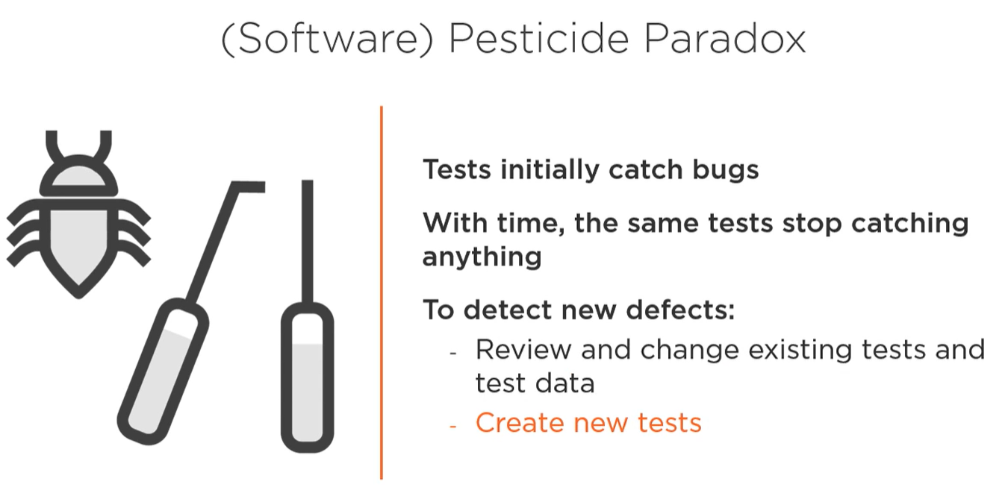
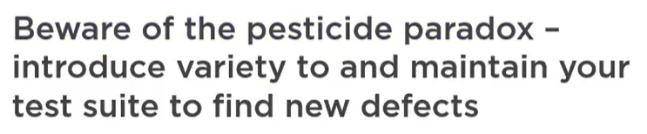
Seven testing principles --> (Beware of the pesticide paradox)
[Beizer 1990]
Notes:
Boris Beizer discovered that using the same pesticide will kill less insect withtime the same with test you have to update
For regression test where not new bug are important to find this principle is less important

Slide 22
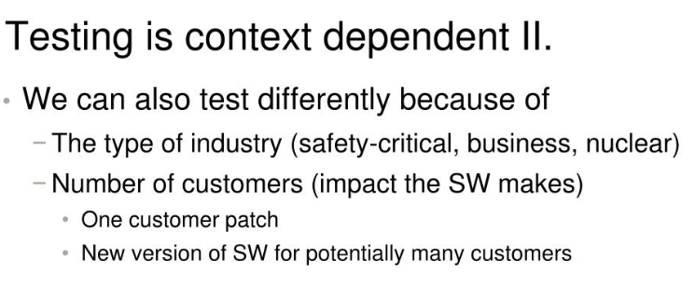
Seven testing principles --> (Testing is context dependent)

Slide 23
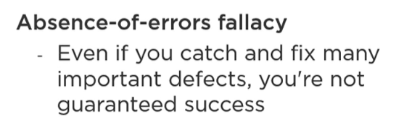
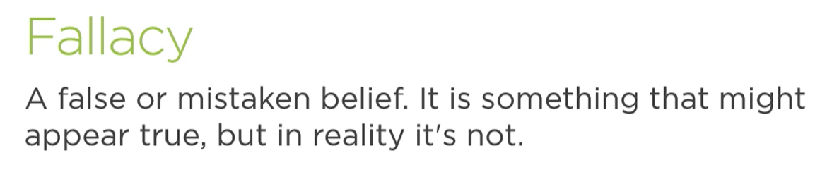
Seven testing principles --> (Absence-of-errors is a fallacy)
Notes:
You can have not bug and good requirement but fail on the market

Slide 24
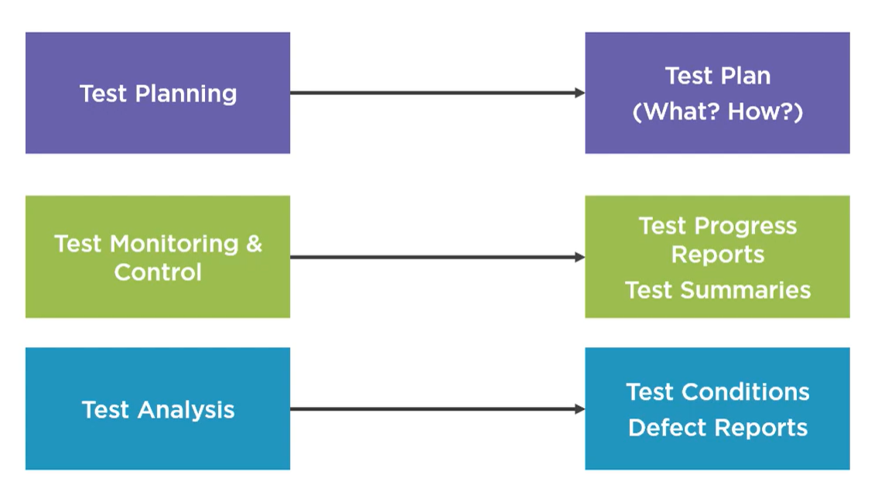
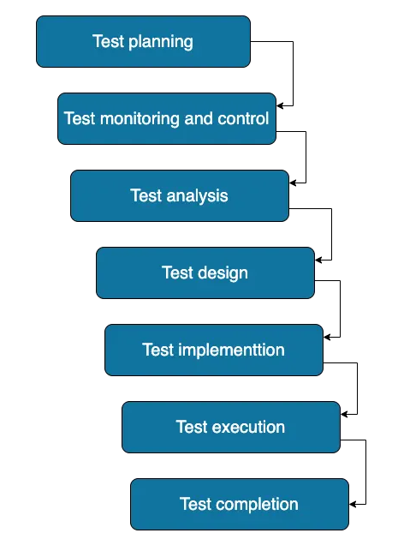
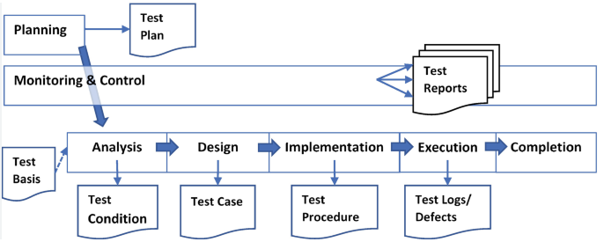
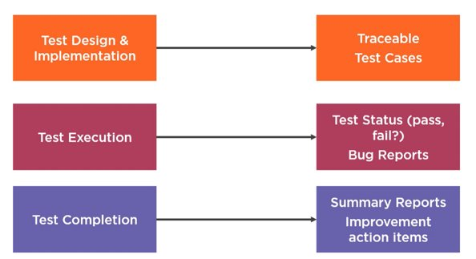
Test Activities

Slide 25
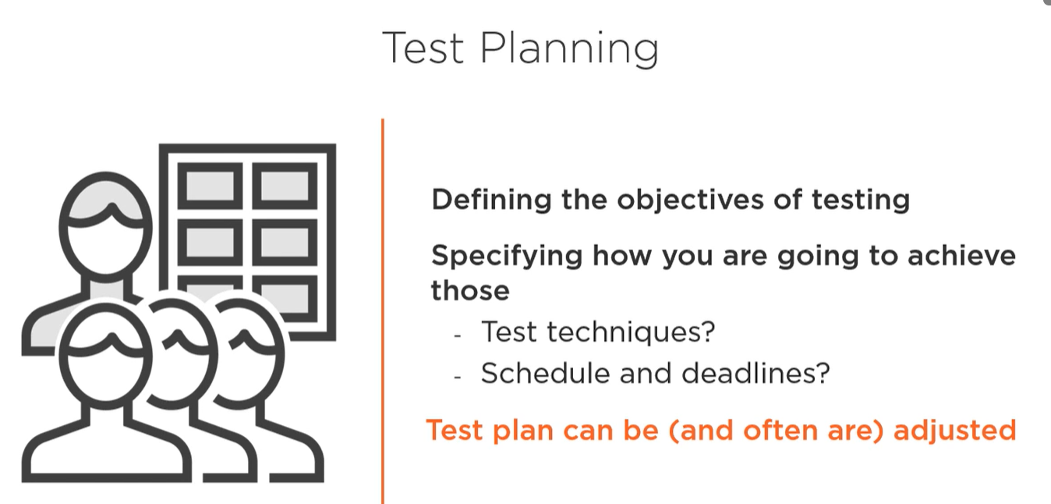
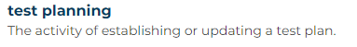
Test Activities
Notes:
How to go from one place to another place without a compass (easly for small project (smaml city) more complex and so need a good organization for big project)

Slide 26
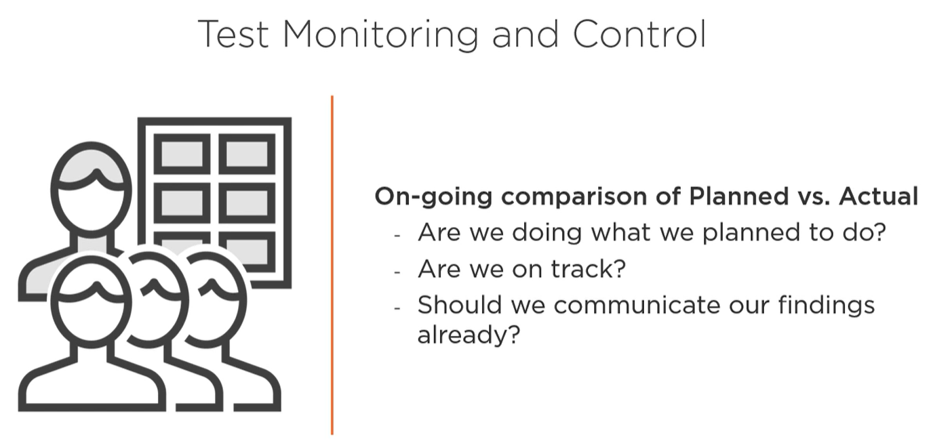
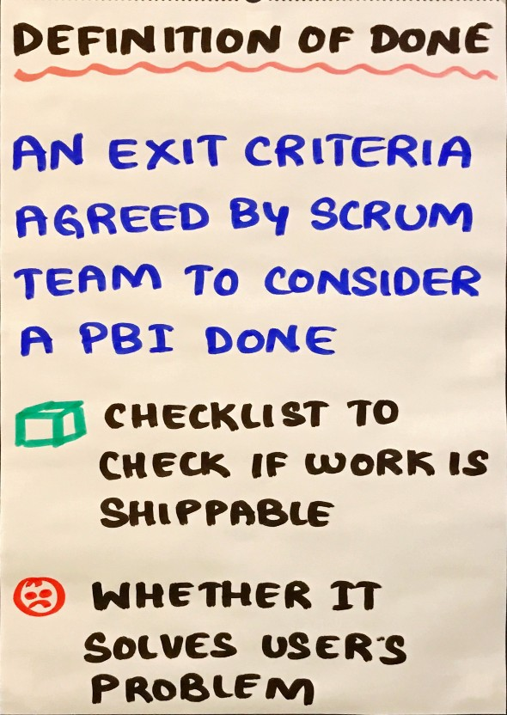
Test Activities
Notes:
To follow the metaphor you need to check if your route is still corect get feednack from someoen that travek with you etc... new route, there will be street closed
For thest monitoring we compare actual progress with what plan
Test control all the actions need to meet these objective in the planm

Slide 27


Test Activities
Features to be tested
Identify test condictions
Capture bi-directional traceability
Requirement specificatuions
Design and implementation information
The implementation of a component or sytesm
Risk analysis report
Notes:
What to test
Test techinique to identifies test condiction --> white or balcjkboxes etc
Find inconsistency early if you identify what to test in this phase
BDD behavipur od the system abd ATTD user view of the system
Capture bi-directional traceability between test basis and test condiction

Slide 28



Test Activities
Notes:
Test analysis what to test --> Test design how to test
Input and data
Going deeper you can find bug based on input data not visible before

Slide 29


Test Activities
Notes:
Often done together with tesd design

Slide 30



Test Activities
Test Execution
Record and versioning test item
Execute the test
Compare actual and expected result
Report defects based on failure observed
Log the outcome
Verify/update bi-directional traceability
Notes:
Test suite assembe in test

Slide 31

Test Activities

Slide 32



Essential skills

Slide 33



Essential skills
Collegues are teammates
Emphasize the value of testing
Recognize that your collegues have pride in their work
Fin the best way to communicate embarassing finding
Cognitive dissonance: the process that makes difficult to process unexpected information, especially bad news

Slide 34
Thank you!
Ivan Cipriani

